Slide 1
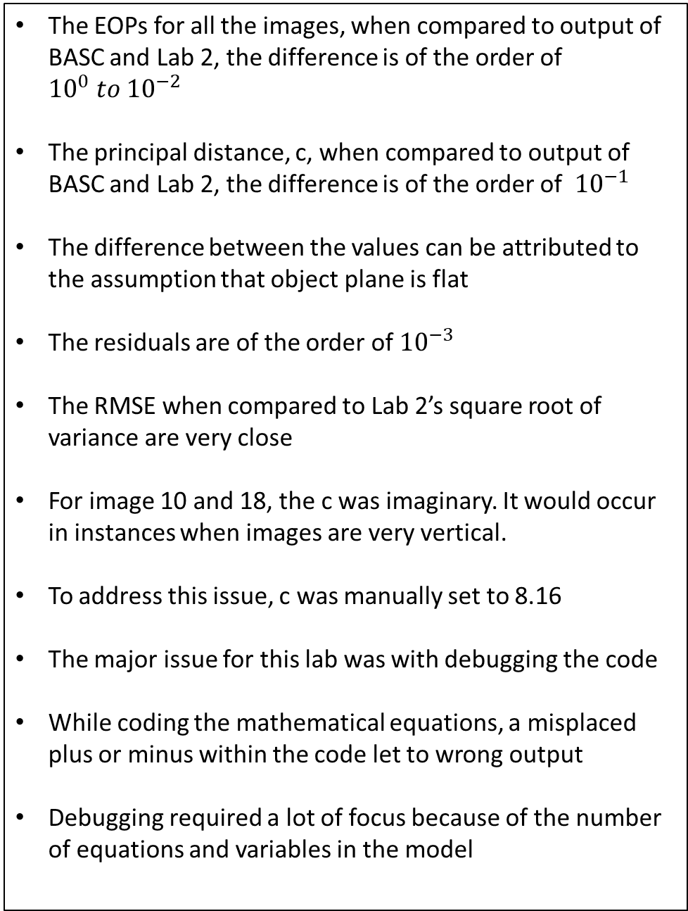
Issues and Explanation
The EOPs for all the images, when compared to output of BASC and Lab 2, the difference is of the order of ${10}^{0} to {10}^{−2}$
The principal distance, c, when compared to output of BASC and Lab 2, the difference is of the order of ${10}^{−1}$
The difference between the values can be attributed to the assumption that object plane is flat
The residuals are of the order of ${10}^{−3}$
The RMSE when compared to Lab 2’s square root of variance are very close
For image 10 and 18, the c was imaginary. It would occur in instances when images are very vertical.
To address this issue, c was manually set to 8.16
The major issue for this lab was with debugging the code
While coding the mathematical equations, a misplaced plus or minus within the code let to wrong output
Debugging required a lot of focus because of the number of equations and variables in the model

Slide 2
Computer Pseudo Code
main.m
Declare common parameters -> IOPs, Ground co-ordinates of targets
For each image:
Get image co-ordinates for each image
Call LSA.m function
LSA.m
Remove distortions from image co-ordinates remove_dist.m
Calculate A matrix by calling calc_A.m
Calculate y matrix by calling calc_y.m
Calculate x_hat by calling calc_x_hat.m
Calculate c, X0, Y0, Z0
Calculate S matrix by calling calc_S.m
Calculate omega phi kappa by calling calc_opk.m
Calculate residuals by calling residuals.m
Code on Github:
https://github.com/Salazar-Prime/photogrammetry/tree/master/Project%203

Slide 3
Computer Pseudo Code
remove_dist.m
Calculate radial distortion
Calculate de-centering lens distortion
Subtract from image co-ordiantes
Calc_A.m
Calculate A for both X and Y
Calc_y.m
Calculate y by alternating xi and yi without distortions
Calc_x_hat.m
x_hat = inv(A'*A)*A'*y;
Calc_S.m
Loop over all GCPs
get xi quaternion and normalize it
get Xi quaternion and normalize it
multiply C for both quaternions to get Si
sum Si to get the S matrix
Code on Github:
https://github.com/Salazar-Prime/photogrammetry/tree/master/Project%203

Slide 4
Computer Pseudo Code
Calc_opk.m
Get eigenvalue and eigenvector for S
Get the eigen vector against maximum eigenvalue
Get rotation matrix
Calculate Omega, Phi, kappa from rotation matrix
Code on Github:
https://github.com/Salazar-Prime/photogrammetry/tree/master/Project%203

Slide 5
Compute Code – main.m
%% Common Parameters
% IOPs
IOP = [6.7451660984e-2,-1.1709829919e-1,8.1671200690];
dist = [-2.9350008918e-4, 9.2190322166e-6,-2.2562559450e-7,6.1878890685e-5,-7.2907688047e-5,0];
% Ground co-ordinates of targets
XA = [-0.044038221723;0.89829592555;1.8428648416;2.7928032424;3.731135328;-0.036927916146;0.90108606018;1.8511589932;2.8010339963;3.7422959221;-0.037704361429;0.90892725171;1.8588605461;2.8062554595;3.7520655984;-0.024722332105;0.91454137562;1.8596674595;2.8078118825;3.7544680979;0;0.9263914178;1.8642980884;2.8111736654;3.7628755375];
YA = [3.751130948;3.7594793917;3.7736433303;3.7823238561;3.7801397656;2.8057675589;2.8180218203;2.8257925207;2.8332144474;2.8378518827;1.8634346772;1.8678901457;1.8758730363;1.8838128654;1.8922797004;0.91840024749;0.92066047041;0.92760553219;0.93553829291;0.94557055946;0;-0.00026178267339;-0.0021390199929;-0.0019752230297;0];
ZA = [0.072640804133;0.048121990404;0;-0.047649472361;-0.070838477818;0.054102199693;0.026008316122;0.0059282538012;-0.023295585379;-0.044574905144;0.016369939657;0.010208246675;0.0071618170061;-0.0096698096332;-0.020910207448;-0.0091692255168;0.003877584251;0.003049069041;-0.0030509411619;-0.0098127723745;0;0.017342094476;0.016047411487;0.006582607018;0];
%% Image 1 - image_09
[EOP_basc,xa,ya] = data(9); % get data for image 9
[c,EOP,res_x,res_y] = LSA(xa,ya,XA,YA,ZA,IOP,dist)
%% Image 1 - image_10
[EOP_basc,xa,ya] = data(10); % get data for image 10
[c,EOP,res_x,res_y] = LSA(xa,ya,XA(1:24),YA(1:24),ZA(1:24),IOP,dist)
%% Image 1 - image_14
[EOP_basc,xa,ya] = data(14); % get data for image 14
[c,EOP,res_x,res_y] = LSA(xa,ya,XA([3:5,7:10,12:15,17:20,22:25]),YA([3:5,7:10,12:15,17:20,22:25]),ZA([3:5,7:10,12:15,17:20,22:25]),IOP,dist);
%% Image 1 - image_18
[EOP_basc,xa,ya] = data(18); % get data for image 18
[c,EOP,res_x,res_y] = LSA(xa,ya,XA,YA,ZA,IOP,dist)
Code on Github:
https://github.com/Salazar-Prime/photogrammetry/tree/master/Project%203

Slide 6
Compute Code – LSA.m
function [c,EOP,res_x,res_y] = LSA(xa,ya,XA,YA,ZA,IOP,dist)
%% parameters
num_GCP = length(xa);
% Unpack IOPs
[xp,yp,~] = assign_IOP(IOP);
%% A and y matrix
[xa,ya] = remove_dist(xa,ya,dist,xp,yp);
[A] = calc_A(num_GCP,xa,ya,XA,YA);
[y] = calc_y(xa,ya);
%% calculate x_hat
[C1,C2,C3,C4,C5,C6,C7,C8] = calc_x_hat(A,y);
%% calculate c
c = sqrt(-1 * (C1*C2+C4*C5)/(C7*C8));
if not(isreal(c))
c = 8.1671200690;
end
%% calculate A'*A
A = [C1,C4,C7;C2,C5,C8;C3,C6,1]*[1,0,0;0,1,0;0,0,c*c]*[C1,C2,C3;C4,C5,C6;C7,C8,1];
%% calculate EOP (X0,Y0,Z0)
X0 = - A(1,3)/A(1,1);
Y0 = - A(2,3)/A(1,1);
Z0 = sqrt(A(3,3)/A(1,1) - X0^2 - Y0^2);
%% calculate EOP (omega,phi,kappa)
S = calc_S(num_GCP,xa,ya,xp,yp,c,XA,YA,ZA,X0,Y0,Z0);
[omega,phi,kappa] = calc_opk(S);
EOP = [X0,Y0,Z0,rad2deg(omega),rad2deg(phi),rad2deg(kappa)];
%% residuals
[res_x,res_y] = residuals(C1,C2,C3,C4,C5,C6,C7,C8,xa,ya,XA,YA);
end
Code on Github:
https://github.com/Salazar-Prime/photogrammetry/tree/master/Project%203

Slide 7
Compute Code – calc_A.m
function [A] = calc_A(num_GCP,xa,ya,XA,YA)
% create an empty A matrix
A = zeros(num_GCP*2,8);
% loop over all ground control points
for i=1:num_GCP
A(2*i-1,:) = [XA(i),YA(i),1, 0,0,0, -1*xa(i)*XA(i), -1*xa(i)*YA(i)];
A(2*i, :) = [0,0,0, XA(i),YA(i),1, -1*ya(i)*XA(i), -1*ya(i)*YA(i)];
end
Compute Code – calc_y.m
function [y] = calc_y(xa,ya)
% alternate merge in order : xa, ya
y = [xa ya]';
y = y(:);
end
Code on Github:
https://github.com/Salazar-Prime/photogrammetry/tree/master/Project%203

Slide 8
Compute Code – calc_x_hat.m
Compute Code – calc_S.m
function [S] = calc_S(num_GCP,xa,ya,xp,yp,c,XA,YA,ZA,X0,Y0,Z0)
S = zeros(4,4);
for i=1:num_GCP
xi = [0,xa(i),ya(i),-c];
xi = xi/norm(xi);
Xi = [0,XA(i)-X0,YA(i)-Y0,ZA(i)-Z0];
Xi = Xi/norm(Xi);
mat1 = [xi(1),-xi(2),-xi(3),-xi(4);
xi(2), xi(1), xi(4),-xi(3);
xi(3),-xi(4), xi(1), xi(2);
xi(4), xi(3),-xi(2), xi(1)];
mat2 = [Xi(1),-Xi(2),-Xi(3),-Xi(4);
Xi(2), Xi(1),-Xi(4), Xi(3);
Xi(3), Xi(4), Xi(1),-Xi(2);
Xi(4),-Xi(3), Xi(2), Xi(1)];
S = S + mat1'*mat2;
trace(mat1*mat2)
end
end
function [C1,C2,C3,C4,C5,C6,C7,C8] = calc_x_hat(A,y)
x_hat = inv(A'*A)*A'*y;
C1 = x_hat(1);
C2 = x_hat(2);
C3 = x_hat(3);
C4 = x_hat(4);
C5 = x_hat(5);
C6 = x_hat(6);
C7 = x_hat(7);
C8 = x_hat(8);
end

Slide 9
Compute Code – residuals.m
Compute Code – calc_opk.m
function [omega,phi,kappa] = calc_opk(S)
[V,D] = eig(S);
[~,id] = sort(diag(D),'descend');
ev = V(:,id(1));
% quat2rotm(ev')
r13 = 2*ev(2)*ev(4) + 2*ev(1)*ev(3);
r12 = 2*ev(2)*ev(3) - 2*ev(1)*ev(4);
r11 = ev(2)^2 + ev(1)^2 - ev(3)^2 - ev(4)^2;
r23 = 2*ev(3)*ev(4) - 2*ev(1)*ev(2);
r33 = ev(4)^2 + ev(1)^2 - ev(3)^2 - ev(2)^2;
phi = asin(r13); % r13
kappa = atan2(-r12/cos(phi),r11/cos(phi))
omega = atan2(-r23/cos(phi),r33/cos(phi))
end
function [res_x,res_y] = residuals(C1,C2,C3,C4,C5,C6,C7,C8,xa,ya,XA,YA)
res_x = xa - (C1*XA + C2*YA + C3)./(C7*XA+C8*YA+1);
res_y = ya - (C4*XA + C5*YA + C6)./(C7*XA+C8*YA+1);
end
Code on Github:
https://github.com/Salazar-Prime/photogrammetry/tree/master/Project%203

Slide 10
Compute Code – data.py
function [EOP_basc,xa,ya]=data(image_no)
switch image_no
case 9
EOP_basc = [1.88968674,3.03586621,3.73500036,-19.1841784,-4.34497759,2.05014903];
xa = [-5.3877;-2.92187;-0.49439;1.79834;3.93369;-5.04787;-2.77407;-0.55643;1.5572;3.55246;-4.71235;-2.63868;-0.61275;1.34004;3.19895;-4.43154;-2.5313;-0.66436;1.1514;2.88537;-4.19557;-2.4407;-0.70131;0.99217;2.62277];
ya = [4.93742;4.84433;4.68172;4.49867;4.29866;2.42494;2.3434;2.23887;2.1432;2.04441;0.30738;0.24322;0.17794;0.13305;0.09228;-1.49013;-1.53833;-1.5756;-1.59753;-1.59671;-3.02777;-3.06606;-3.09871;-3.09563;-3.07743];
case 10
EOP_basc = [1.68045678e+000 2.16587520e+000 3.50855335e+000 -4.14855263e-001 -4.93725230e+000 9.24769326e+001];
xa = [4.2568;4.0854;3.8851;3.68;3.479;1.9221;1.7977;1.6796;1.555;1.4339;-0.3967;-0.4724;-0.5334;-0.5915;-0.6454;-2.6632;-2.71;-2.7285;-2.7338;-2.7224;-4.81;-4.8779;-4.8782;-4.8346];
ya= [4.6788;2.3093;0.0418;-2.0823;-4.0521;4.7589;2.3888;0.1175;-2.0216;-4.02;4.8045;2.45;0.1921;-1.9492;-3.9707;4.8258;2.5321;0.2918;-1.8528;-3.8693;4.8076;2.5851;0.3697;-1.7626];
case 14
EOP_basc = [1.00952899e+000 2.53318361e+000 2.80635782e+000 -8.94008150e+000 -1.70515538e+001 9.11810993e+001];
xa = [5.0408;4.5063;4.0613;2.4057;2.1457;1.9236;1.7394;-0.5466;-0.5072;-0.48;-0.4562;-3.1775;-2.9114;-2.6867;-2.495;-5.4743;-5.0707;-4.6992;-4.374];
ya = [-0.3354;-2.7179;-4.6482;2.6935;-0.1767;-2.5023;-4.414;2.7038;-0.0294;-2.2763;-4.1595;2.7274;0.1323;-2.0413;-3.8797;2.7125;0.2538;-1.841;-3.6312];
case 18
EOP_basc = [2.10162316e+000 1.19465520e+000 3.69958966e+000 1.33667830e+001 1.46559054e+000 9.02308070e+001];
xa = [3.2893;3.295;3.2772;3.2471;3.2149;1.5691;1.574;1.5795;1.5697;1.557;-0.3378;-0.3441;-0.3375;-0.3381;-0.3412;-2.4459;-2.481;-2.4964;-2.5036;-2.4987;-4.7066;-4.8269;-4.8928;-4.9179;-4.8917];
ya = [3.8357;2.0059;0.1629;-1.6697;-3.476;4.0453;2.1277;0.1844;-1.7649;-3.6961;4.2673;2.2563;0.2058;-1.8635;-3.9356;4.4805;2.4023;0.2466;-1.9536;-4.1554;4.6783;2.5441;0.2765;-2.0524;-4.369];
end
end

Slide 11
Compute Code – assign_IOP.py
function [xp,yp,c]=assign_IOP(IOP)
xp = IOP(1);
yp = IOP(2);
c = IOP(3);
end
Code on Github:
https://github.com/Salazar-Prime/photogrammetry/tree/master/Project%203

